Slide 1

AI_ASSIGNMENT - 2 CS22B044 R.GREESHMA CS22B041 P.Snehitha
Algorithms Implemented
Minimax:
Explores full game tree to find the optimal move by assuming opponent plays optimally.
Alpha-Beta Pruning:
Optimized version of Minimax by pruning irrelevant branches, reducing computation
Environment Used: Chess environment
Evaluation Function:

Slide 2
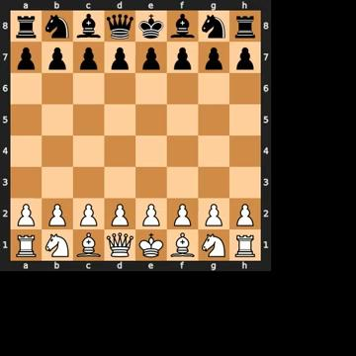
Evaluation Function
We implemented a material-based evaluation function. It assigns scores based on the number and type of pieces remaining for each side. This function adds the total material value of the white pieces and subtracts that of the black pieces, returning a numerical score that guides the algorithm’s decision-making. A positive score favors White, and a negative score favors Black.
Video:

Slide 3
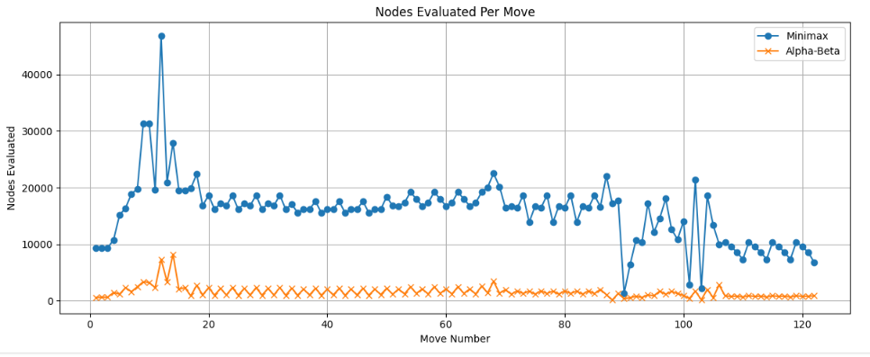

Slide 4
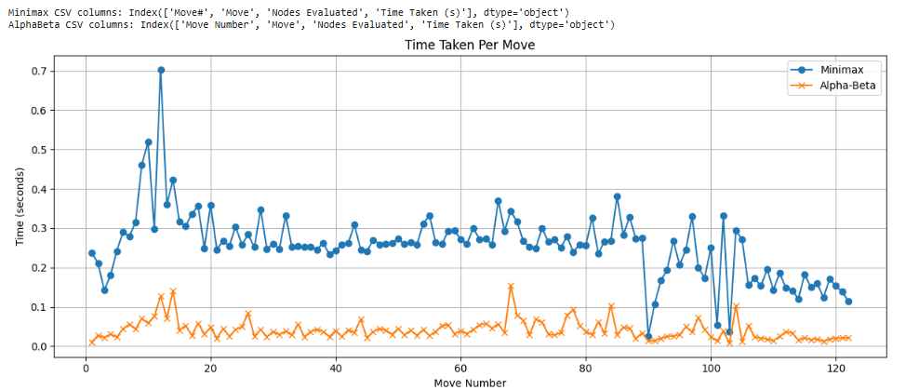
Performance comparison of Minimax Vs Alpha-Beta at each move

Slide 5
Reasons for Better Performance of Alpha-Beta Pruning
Efficient Pruning: Alpha-Beta skips irrelevant branches, reducing node evaluations drastically.
Faster Computation: It reaches decisions up to 6x faster than Minimax by processing fewer nodes.
Reduced Redundancy: Alpha-Beta avoids reprocessing repetitive moves, unlike brute-force Minimax.
Smarter Depth Handling: It evaluates fewer nodes in complex turns while maintaining decision quality.
Real-Time Viability: Alpha-Beta delivers rapid responses ideal for fast-paced game environments.

